Slide 1
Sawatdee Thailand
Building better dissemination systems for national development indicators
Phnom Penn, Cambodia
21-25 April 2014

Slide 2
Investigation of Metadata
Nampung Chirdchuepong
National Statistical office
nampung.gs4@gmail.com
Notes:
Since Thailand have sent some data and metadata to the UN countrydata
They have been compare with the number from International Agency and found the difference
So it is needed to be investicate

Slide 3
Project on National Development Indicator
Building better dissemination systems
for national development indicators
Data & metadata
Objectives of Agreement
Establishment and maintain the
institutional framework
Maintain the existing data exchange infrastructure
Undertake the development of a single central repository
Responsible for the recruitment and administration
Prepare and submit reports
Notes:
If we look for the project background
These are
Bring national and international data under the one platform and
Improving the collation, availability and dissemination
So to compare the data , we should know metadata of each data
So the objectives of agreement needed NSO
Establish and maintain the framework, infrastructure and so on
Apart from that , output of the project, it should have data and metadata in the country data system

Slide 4
Building better dissemination systems
for national development indicators
Indicators selected
The Millennium Development Goals
International Institute for Management Development : IMD
ASEAN Core Indicators
Education for All Goals
Notes:
In this project Thailand has selected 4 sets of indicators to be the pilot project
Namely MDGs, EFA, IMD and ASEAN core indicators

Slide 5
Why metadata is so important?

Slide 6
Indicators
Building better dissemination systems
for national development indicators
Population below national poverty line
Share women in wage employment in the non-agricultural sector
Maternal mortality rate
Under-five mortality rate
Tuberculosis death rate
Notes:
After looking at the Undata , we found that there are some difference among the 2 number
If we did not explain how the data come, no one know why are difference
In this case we will look at the 5 indicators
There are – population below national poverty line
- Share women in wage employment in the non-agricultural sector…

Slide 7
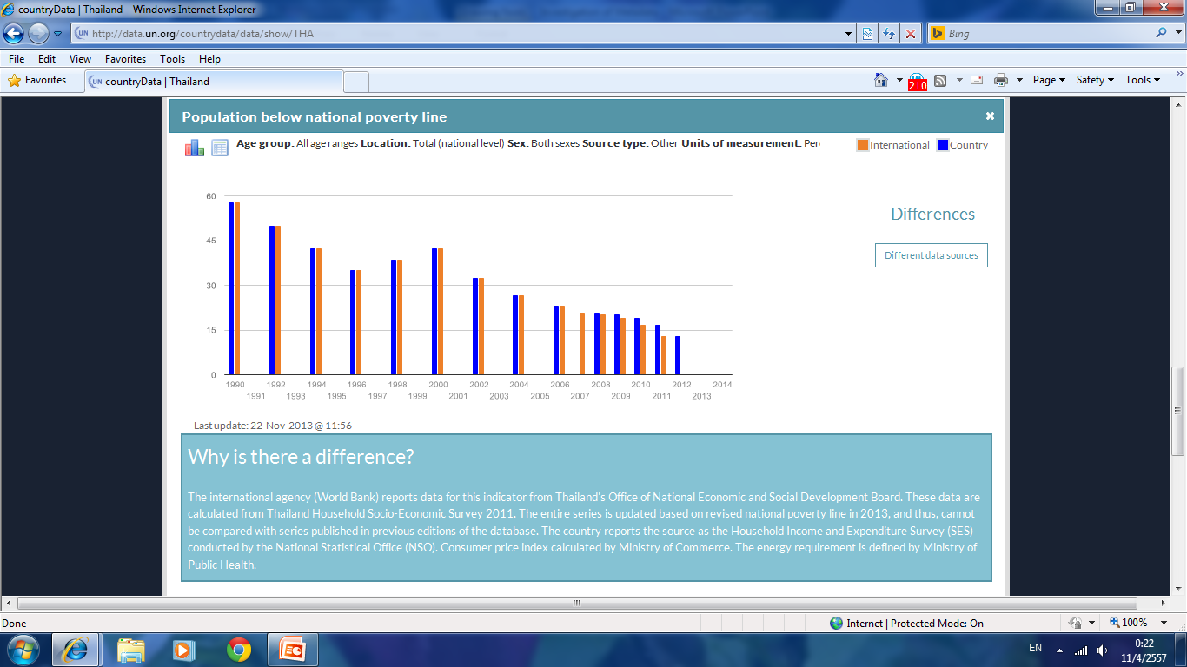
Population below national poverty line
Building better dissemination systems
for national development indicators
The national poverty rate is the percentage of the total population living below the national poverty line
The difference
The same method of computation & the same data set
But we put the right data in the wrong year
Human Error
Notes:
If you look at the graph shown in UNData, there are slightly difference in the year 2007
And if you
Usually this survey have done every 2 years, then in 2007, NSO conduct every year

Slide 8
Population below national poverty line
Socio_economic survey - NSO
Quarterly, annually
Poverty - National Economic and Social Development Board
Anuually

Slide 9
Share women in wage employment in the non-agricultural sector
Building better dissemination systems
for national development indicators
expressed as a percentage of total wage employment in the same sector
Notes:
The share of female workers in wage employment in the non-agricultural sector expressed as a percentage of total wage employment in that same sector.
This indicator is computed by taking a percentage of female workers in wage employment in the non-agricultural sector, to the total wage employment in the non-agricultural sector.
Share of female workers in wage employment in the non-agricultural sector
= Female wage employment in the non-agricultural sector x 100%
Total wage employment in the non-agricultural sector
Where:
The non-agricultural sector includes industry and services. ‘Industry’ includes mining and quarrying (including oil production), manufacturing, construction, electricity, gas, and water, corresponding to divisions 2-5 in the International Standard Industrial Classification of All Economic Activities (ISIC-Rev.2¹) and to tabulation categories C-F in ISIC-Rev. 3¹. ‘Services’ include wholesale and retail trade and restaurants and hotels; transport, storage, and communications; financing, insurance, real estate, and business services; and community, social, and personal services, corresponding to divisions 6-9 in ISIC-Rev. 2, and to tabulation categories G-Q in ISIC-Rev. 3.
Employment refers to people 15 – 60 years of age who worked at least 1 hour or held a job during the week prior to the survey.
Wage employment refers only to wage earners and salaried employees, or "persons in paid employment jobs". Employees are typically remunerated by wages and salaries, but may be paid by commission from sales, piece-rates, bonuses or payments in kind such as food, housing, training, etc. These persons are in wage employment as opposed to self-employment – that is employers, own-account workers, members of producers' cooperatives and contributing family workers.

Slide 10
Share women in wage employment in the non-agricultural sector
Building better dissemination systems
for national development indicators
Labor force survey - NSO
Monthly, quarterly and annually
Definition – ILO
Non-agricultural includes industry and services
Notes:
The number come from Labour force survey conduct by NSO
The definition follow ILO and non-agricultural includes industry and services
When we invest and bring the number to create new graph, we found that no any number difference

Slide 11
Share women in wage employment in the non-agricultural sector
Building better dissemination systems
for national development indicators
Share of wage of women in wage employment
Human error
Notes:
Where it comes
They put the number of share of wage of women in wage employment per wage of total women in wage emmployment

Slide 12
Maternal mortality rate
Building better dissemination systems
for national development indicators
The ratio of the number of maternal deaths during a given time period per 100,000 live births during the same time-period
Countrydata
Use death registration only - Ministry of Interior
MMR = No. of maternal death
No of live birth
from DevInfo database
Notes:
The maternal mortality ratio (MMR) is the ratio of the number of maternal deaths during a given time period per 100,000 live births during the same time-period. A maternal death refers to a female death from any cause related to or aggravated by pregnancy or its management (excluding accidental or incidental causes) during pregnancy and childbirth or within 42 days of termination of pregnancy, irrespective of the duration and site of the pregnancy.
This indicator is computed by taking a ratio of number of maternal deaths by total recorded (or estimated) number of live births.
The maternal mortality ratio (MMR) = Number of maternal deaths
Number of live births
Where:
The maternal mortality ratio can be calculated by dividing recorded (or estimated) number of maternal deaths by total recorded (or estimated) number of live births in the same period and multiplying by 100,000.
Measurement requires information on pregnancy status, timing of death (during pregnancy, childbirth, or within 42 days of termination of pregnancy), and cause of death.
It is important to note that not all deaths which occur temporally to pregnancy are considered "maternal deaths". Maternal deaths are a specific subset of deaths which occur during pregnancy, childbirth and the puerperium and can be further divided into two groups, namely direct and indirect obstetric deaths. Direct obstetric deaths result from obstetric complications of the pregnant state (pregnancy, labor and puerperium); from interventions, omissions or direct treatment; or from a chain of events resulting in any of these. Indirect deaths result from previously existing disease or disease that developed during pregnancy and was not directly due to obstetric causes but was aggravated by the physiologic effects of pregnancy. Deaths which do not meet these criteria, such as those which occur as a result of accidents, are defined by the more general term, "death occurring in pregnancy, childbirth or the puerperium" (previously referred to as "pregnancy related deaths").
The maternal mortality ratio can be calculated directly from data collected through vital registration systems, household surveys or other sources. However, maternal mortality data from all sources have limitations, particularly related to the underreporting and misclassification of maternal deaths (see “comments and limitations” section). The World Health Organization (WHO), United Nation’s Children’s Fund (UNICEF), United Nations Population Fund (UNFPA), The World Bank (WB), and United Nations Population Division (UNPD) have developed a method to adjust existing data in order to take into account these data quality issues. This method involves adjusting existing data for underreporting and misclassification of deaths and model-based estimates are made for countries with incomplete or no reliable national level data.

Slide 13
Maternal mortality rate
Building better dissemination systems
for national development indicators
Year | Country Data | MDG_ UN | MDG_ NESDB* | MGD_Report (health) | MGD_Report (health on web) | website Health Stat.
1990 |  | 54
1991
1992
1993
1994 | 10.8
1995 | 10.7 | 54
1996 | 12.7
1997 | 9.7 |  |  |  |  | 9.7
1998 | 7 |  |  |  |  | 7.0
1999 | 12.3 |  |  |  |  | 12.3
2000 | 13.2 | 66 |  |  |  | 13.2
2001 | 12.9 |  | 12.9 |  |  | 12.9
2002 | 14.7 |  | 14.7 |  |  | 14.7
2003 | 13.7 |  | 13.7 |  |  | 13.7
2004 | 13.3 |  | 13.3 | 44.5 |  | 13.3
2005 | 12.2 | 54 | 12.2 |  |  | 12.2
2006 | 11.7 |  | 11.7 | 41.6 |  | 11.7
2007 | 12.2 |  | 12.2 | 49.9 | 39.74 | 12.2
2008 |  |  | 11.3 | 38.5 | 37.87 | 11.3
2009 |  |  | 10.8 |  | 35.16 | 10.8
2010 |  | 48 | 10.2 | 31.8 |  | 10.2
2011 |  |  | 8.9 |  |  | 8.9
Notes:
There are many sources provide data for maternal mortality
Inthis case the example I show you just 5 sources
From the MDG_report of NESDB
MDG report about health
The country data come from death registration from ministry of Interior. The number as same as shown in col 3 and 6. through in col 4 and 5 come from the registration but combine from many source.
The Ministry of Public health, is responsible to produce this data
However, the data in countrydata, we bring from the TPDInfo or DevInfo
At least it has been already chosen once

Slide 14
Maternal mortality rate
Notes:
If we bring all the number to create graph,

Slide 15
Under-five mortality rate
Building better dissemination systems
for national development indicators
The probability of a child born in a specified year dying before reaching the age of 5 if subject to current age-specified mortality rate
Country data
Indirect method
Ministry of Public health
From DevInfo database
Notes:
The children under 5 mortality rate is the probability (expressed as
This indicator is computed by taking a ratio between the number of mortality of infant under 5 years old in the year, to the number of live birth from the same period.
The children under 5 mortality rate per 1,000 live births =
The number of mortality of infant under 5 year old in the year x 1,000
the number of live birth from the same period

Slide 16
Under-five mortality rate
Year | Country Data | MDG_UN | MDG_ NESDB | MGD_Report (Health) | website Health Stat.
1990 |  | 38.2 | 12.8 | 12.8
1991 |  | 36.1 | 12.8 | 12.8
1992 |  | 34.1 | 11.7 | 11.7
1993 |  | 32.4 | 11.6 | 11.6
1994 |  | 30.7 | 11.4 | 11.4
1995 |  | 29.1 | 11.6 | 11.6
1996 |  | 27.7 | 10.5 | 10.5
1997 |  | 26.3 | 9.1 | 9.1
1998 |  | 25.0 | 16.9 | 16.9
1999 |  | 23.8 | 14.5 | 14.5
2000 | 43.2 | 22.6 | 11.9 | 11.9
2001 | 44.5 | 21.5 | 12.3 | 12.3
2002 | 44.4 | 20.4 | 11.7 | 11.7
2003 | 44.9 | 19.4 | 12.0 | 12.0
2004 | 44.0 | 18.5 | 11.3 | 11.3
2005 | 45.6 | 17.6 | 10.8 | 10.8
2006 | 45.4 | 16.8 | 10.5 | 10.5
2007 | 45.3 | 16.0 | 10.0 | 10.0 | 10.25
2008 | 45.7 | 15.3 | 9.9 | 9.9 | 9.94
2009 |  | 14.7 |  |  | 9.77
2010 |  | 14.2
2011 |  | 13.7
2012 |  | 13.2 |  | 9.1
Notes:
For country data we use indirect method instead,
There are many sets of data represent “under-five mortality rate. Through they come from the same ministry: ministry of Public Health
In cases of the health sector could not have the conclusion which data should represent the number of the country.
then the metadata is very necessary to explain the number we choose

Slide 17
Under-five mortality rate

Slide 18
Tuberculosis death rate
Building better dissemination systems
for national development indicators
Estimated number of deaths due to tuberculosis (TB) in a given time period
From the report of National TB Planning
Notes:
Which cover only the death of people while they were cure of TB without look at the reason of death and only in the registration in the national TB planning
Which is not cover all the TB death of the country

Slide 19
Tuberculosis death rate
Building better dissemination systems
for national development indicators
Year | Country Data | MDG_UN | MDG_NESDB* | MGD_Report (Health) | MDG Report2009
1990 |  | 19 |  | 6.8
1991 |  | 18 |  |  | 6.5
1992 |  | 17 |  |  | 6.3
1993 |  | 17 |  |  | 6.1
1994 | 5.9 | 18 |  |  | 5.9
1995 | 7.0 | 19 |  | 7.0 | 7.0
1996 | 7.7 | 21 |  |  | 7.7
1997 | 6.2 | 24 |  |  | 6.2
1998 | 7.2 | 26 | 5.2 |  | 5.8
1999 | 8.6 | 29 | 7.6 |  | 5.6
2000 | 10.1 | 31 | 9.6
2001 | 10.1 | 31 | 9.5
2002 | 10.8 | 30 | 10.0
2003 | 11.0 | 28 | 10.1 |  | 4.8
2004 | 9.7 | 26 | 9.0 |  | 4.2
2005 | 8.9 | 23 | 8.2 | 3.93 | 3.9
2006 | 8.3 | 21 | 7.6 |  | 3.8
2007 | 7.7 | 19 | 7.1 | 4.11 | 4.1
2008 |  | 18 | 6.9 |  | 9.0
2009 |  | 16 | 7.2
2010 |  | 15 | 7.0
2011 |  | 14 | 6.9 | 7.1
2012 |  |  | 7.7

Slide 20
Tuberculosis death rate
Building better dissemination systems
for national development indicators
Notes:
Most 0f data within country quite similar but difference between national and international data
However, because of the difference in the coverage we count
The provider needs to adjust and update the data, so it is needed to include from another source such as from all health center include private hospital

Slide 21
Discrepancies
Building better dissemination systems
for national development indicators
Human error
Methodology
Coverage
Etc….
Notes:
As I said on another day, OS of health sector has no conclusion to represent the national number
That why the metadata should include in the dissemination,
So it can be known how and where there are

Slide 22
Building better dissemination systems
for national development indicators
Thank you

Slide 23
The metadata in statXchange
Indicator
Definition
Project
Frequency
Unit
Source type
location
Source detail/ provider
The new version add up more DSD & MSD

Slide 24
Building better dissemination systems
for national development indicators

Slide 26
Elements
Page

Slide 27
Building better dissemination systems
for national development indicators
Project on National Development Indicators
Workshop to selected indicators framework
- Economic
- Social
- Environment
Study indicators (Master Plan, web site, Questionnaires etc)
Project approved
Sign in Cooperation agreement
Working group
-Set up working group
-List of Indicators with metadata
- release calendar
- responsible agency
- time frame
Training / workshop
to officers
Report on National development indicators
Metadata Handbook
Report on quality assessment
Report on meeting / seminar /training
- hand book for user
Hand book for administrator
Network meeting
Web site / e-book
Notes:
Flow of the project
ขออนุมัติโครงการ
ลงนามในข้อตกลง
แต่งตั้งคณะทำงาน
ศึกษา รายการตัวชี้วัด จากแหล่งต่าง ๆ (แผนแม่บท, web site, questionnaires, ตัวชี้วัดสากล เช่น MDGs, ASEAN)
Workshop เพื่อคัดเลือกรายการ ปฏิทินการนำเข้า/เผยแพร่ หน่วยงานรับผิดชอบ
จัดอบรม
นำเข้า data & metadata
ติดตาม/ตรวจสอบ/ช่วยเหลือ
นำเสนอในระบบ
เชื่อมโยงไปยัง UNData

Slide 28
Building better dissemination systems
for national development indicators
Problem
duplication
Lack of data
Out of date
Integration & Exchange
No standard
Not correct
User problem - confuse
Statistical Master Plan
Ministry Private
Department NGOs
Enterprise public
people
Notes:
28
However, the data themselves could make users confuse because of many problems such as redundancy or duplication and some time lack of data . Moreover, there are different methods and standard of collection. It results in wasting both budget and manpower. Therefore, NSO set up the Statistical Master Plan under the Statistical Act.
The concept of data exchange was initiated before joining with UNSD project It’s starting from the problems that many agencies produce or collect the data and information on their function or activities.

